Slide 1
ACADEMIC PROJECT
CV-Based Sales
Analytics Engine
Computer vision and conversational AI for smart-retail shelf monitoring and automated procurement.
Presenters:
Harish Badhreswar S (23619114)
Vignesh P (23619141)
Sanjay S (23619132)
Notes:
Introduce the project as an edge-to-cloud retail intelligence system. The focus is shelf visibility, sales analytics, and automated procurement actions.

Slide 2




Problem Statement
Physical shelf reality
Invisible in-aisle behavior
POS systems can report inventory while shelves are physically empty, occluded, or misplaced.
Traditional checkout data is blind to in-aisle dwell time, pickup abandonments, congestion, and concealment.
Delayed intervention
Operational need
Manual restocking audits are delayed and reactive.
Retail teams need continuous shelf visibility, faster loss prevention, and proactive replenishment.
Notes:
Emphasize the disconnect between transaction records and physical shelf conditions. The system must observe what happens in the aisle and turn that observation into timely operational action.

Slide 3
02 · PROJECT INTENT
Objectives
From edge observation to verified procurement action.
01
02
03
04
05
Monitor
Fuse
Filter
Support
Trigger
Monitor shelves and shopper activity with edge computer vision.
Fuse camera observations with live POS transactions.
Reduce false stockout alerts through temporal persistence and occlusion handling.
Support vision-to-cart self-checkout and shrinkage analysis.
Trigger procurement workflows and digital tax invoices from verified low-stock events.
Notes:
Walk across the five objectives. The sequence moves from sensing and reconciliation to trustworthy alerts, customer-facing checkout support, and automated procurement.

Slide 4
03 · PRIOR WORK
Literature Review
Three technology foundations, one operational direction.
YOLO11 / Ultralytics
Retail AI copilots
Firebase and MCP
Edge object detection with strong inference capability, but limited retail operational logic.
Tool orchestration and retrieval, but dependence on clean databases.
Schema-safe telemetry and tool bindings for operational environments.
Project position: the intersection of edge vision, retail intelligence, and automated operations.
Notes:
Frame the review as complementary foundations. Detection, copilots, telemetry, and tool bindings each solve part of the problem. This project connects them around retail operations.

Slide 5
04 · CONTRIBUTION
Research Gap
The missing link is the operational loop.
Where systems stop
Gap addressed
Bounding boxes or isolated camera demos.
Detections not converted into SKU-level inventory events.
Inspection, occlusion, and genuine stockout states conflated.
A deployable edge-to-cloud retail pipeline with temporal filtering, POS reconciliation, operational alerts, and automated restock actions.
Inventory monitoring · self-checkout · loss prevention · analytics · supplier procurement
Many systems do not integrate these capabilities in one loop.
Notes:
Contrast isolated perception with an integrated operational pipeline. The contribution is not another bounding-box demo; it is the conversion of observations into reconciled inventory events, alerts, and restock actions.

Slide 6
05 · IMPLEMENTATION FLOW
Proposed Methodology
Five connected stages turn shelf activity into retail intelligence.
01
02
03
04
05
Camera and browser inference
Telemetry synchronization
Inventory intelligence
Operational action
Analytics
Calculate dwell, footfall, conversion, shrinkage, and runout runway.
Send lightweight JSON events through Firebase Firestore and MCP.
Apply persistence, occlusion, POS, and planogram rules.
Generate alerts, self-checkout updates, purchase orders, and invoices.
Detect products, shoppers, and shelf states.
Notes:
Describe the methodology as a chain. Each stage produces information consumed by the next, while the final analytics layer measures shopper behavior, shrinkage, and the remaining runout runway.

Slide 7
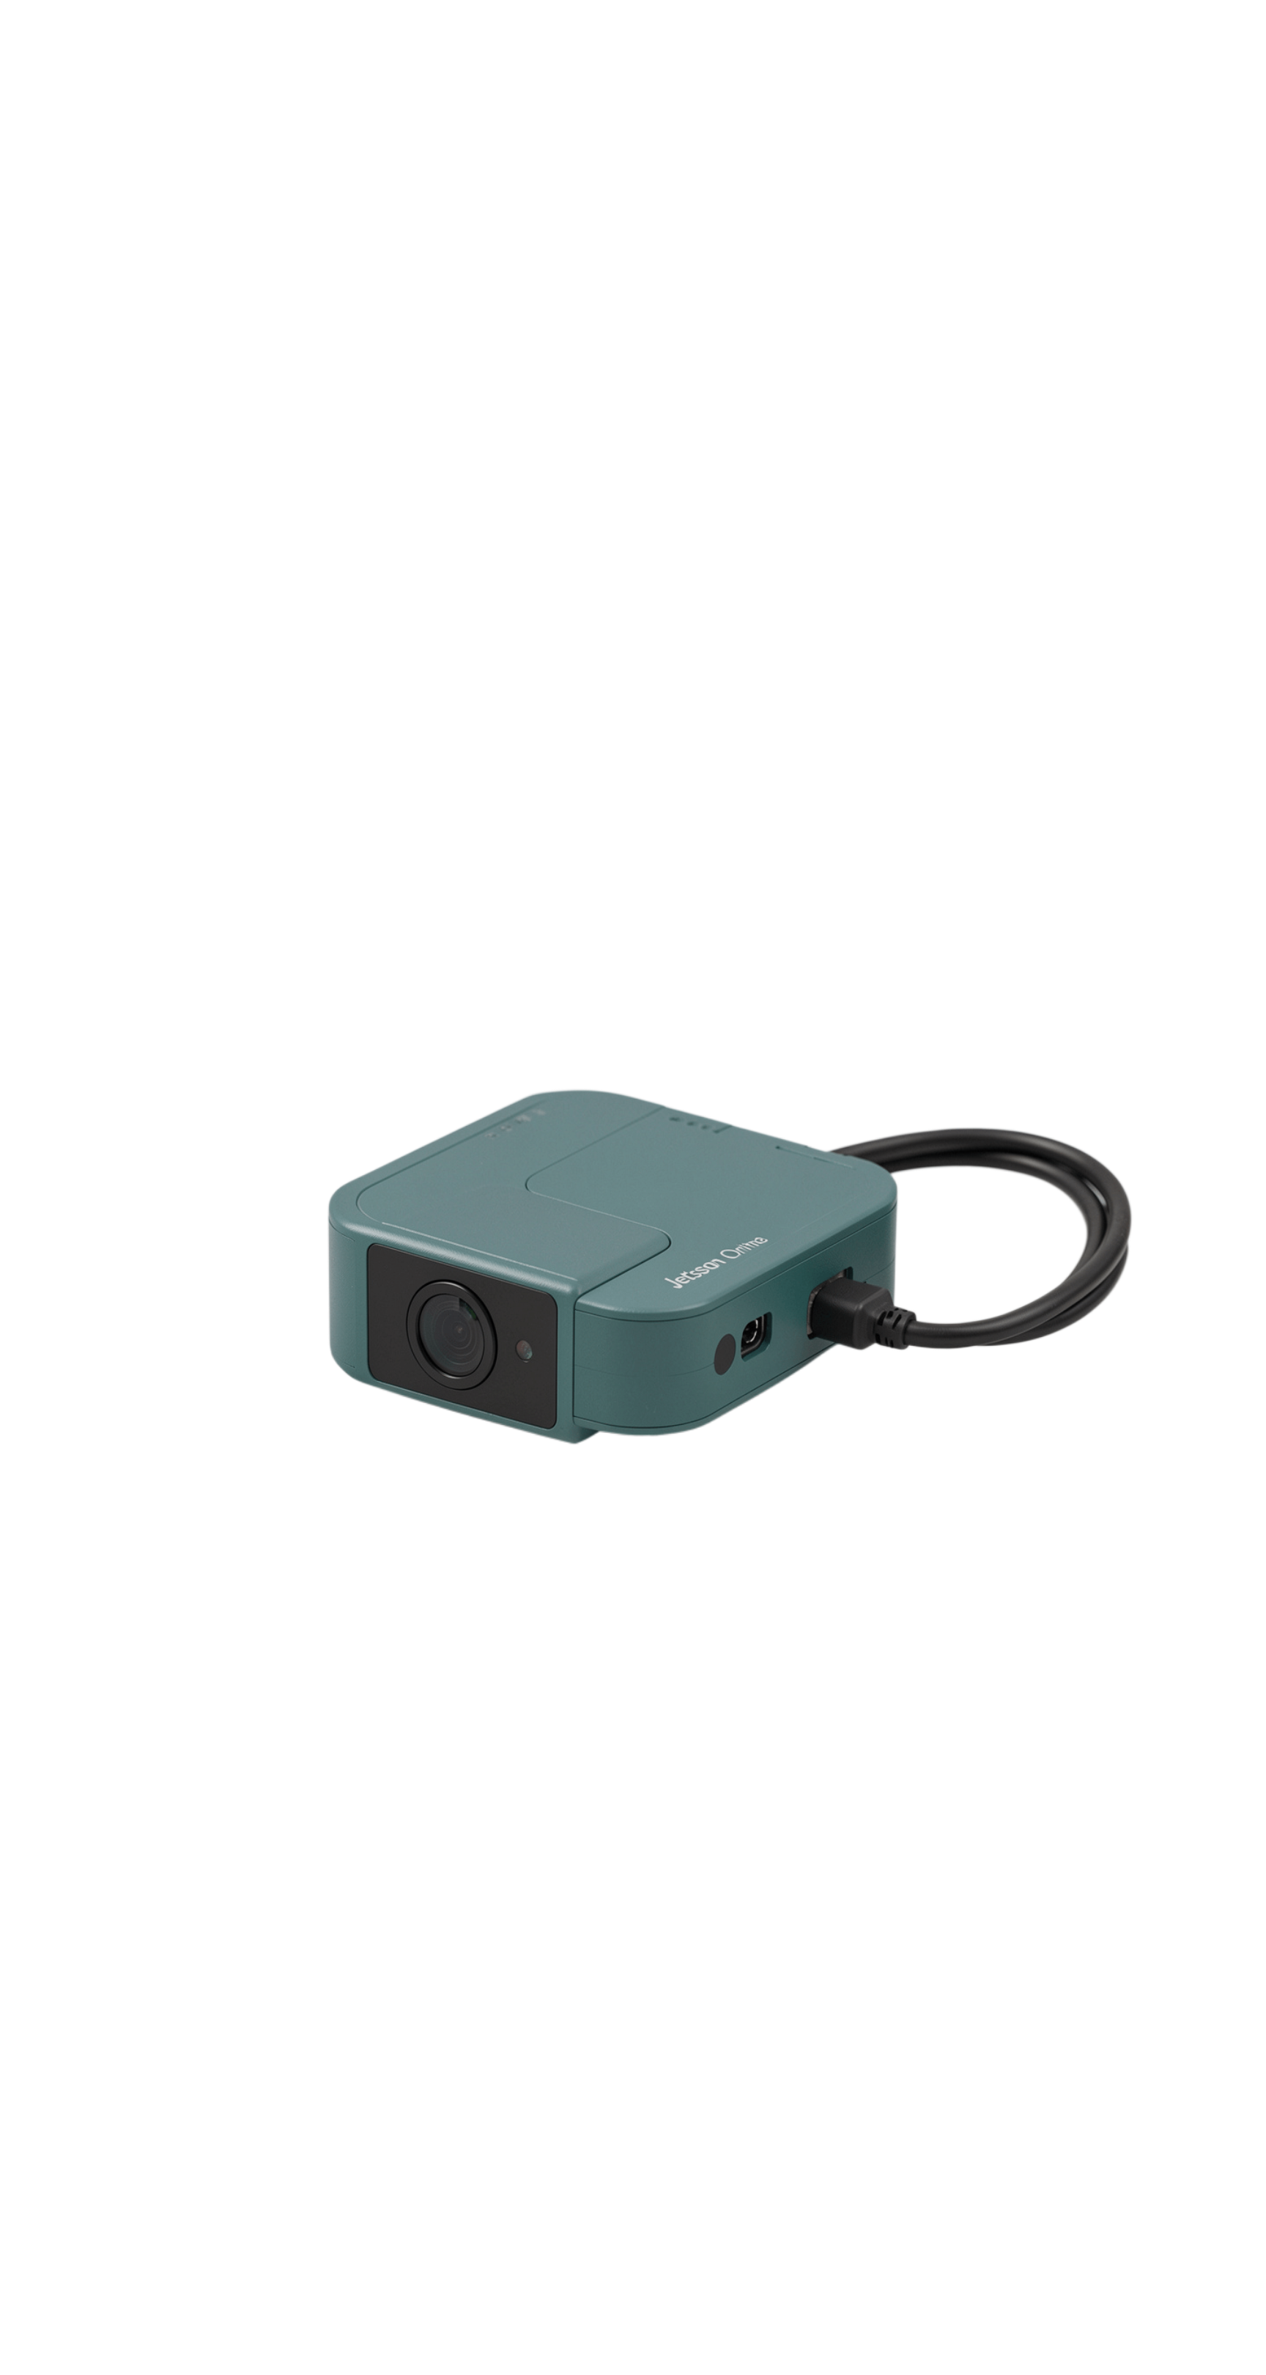





06 · DEPLOYMENT CONTEXT
Hardware Requirements
Multi-channel CCTV or RTSP camera feeds: aisle and concourse coverage.
Edge computer or local GPU: target such as Jetson Orin Nano.
Optional camera wall display: operator monitoring.
Store POS and checkout environment: transaction reconciliation.
Network connectivity: telemetry and operational services.
Notes:
Hardware spans sensing, local processing, operator visibility, transaction reconciliation, and connectivity. The edge target is represented by the Jetson Orin Nano example.

Slide 8
07 · IMPLEMENTATION STACK
Software Requirements
Capability | Required technology
Production edge inference | YOLOv11 / TensorRT
Browser-side detection | TensorFlow.js and COCO-SSD for webcam and video detection
Application structure | Vanilla ES6 modules with zero external bundler
Telemetry and tools | Firebase Firestore, MCP tool bindings, Web Audio API, and dashboard components
Operational review | Reporting and invoice generation
The stack supports edge inference, browser prototyping, schema-safe telemetry, and operational outputs.
Notes:
Separate production inference from browser-side experimentation. Firestore and MCP provide the telemetry and tool-binding layer, while reporting and invoice generation complete the operational review surface.

Slide 9
08 · EXECUTION PLAN
Project Timeline and Milestones
1
2
3
Literature review and research-gap definition
Camera, shelf, POS, and product-schema design
Edge detection and browser inference prototype
4
5
6
Telemetry synchronization and inventory rules
Self-checkout, loss prevention, and procurement modules
Analytics, testing, Review 2 demonstration, and future-work planning
Actual dates should follow the project schedule if available.
Notes:
Walk the milestones in order. Actual dates should follow the project schedule if available; no dates are added because the approved brief does not provide them.

Slide 10
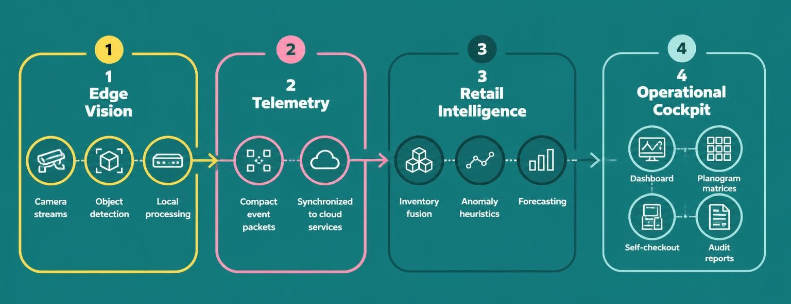
09 · SYSTEM ARCHITECTURE
System Design
A four-layer architecture connects the store floor to the operational cockpit.
Notes:
Close the technical story with the architecture. Edge Vision observes, Telemetry synchronizes, Retail Intelligence interprets, and the Operational Cockpit turns the result into dashboards, self-checkout updates, planogram matrices, and audit reports.

Slide 11

REVIEW 2 · SYSTEM OVERVIEW
Eight modules
connect observation
to action
MODULES_01–08.LOG
M1–M2
M3–M4
multi-camera edge vision, browser inference, shelf and planogram state detection
telemetry synchronization, event logs, POS fusion, and hysteresis filtering
Loading...
M5–M6
M7–M8
vision-to-cart self-checkout plus shrinkage and loss-prevention alerts
procurement, payments, tax invoices, dashboards, heatmaps, and runout forecasting
CV-BASED SALES ANALYTICS ENGINE
Notes:
Frame the review around the full operating chain: eight modules move from what the store observes to what the business can act on.

Slide 12

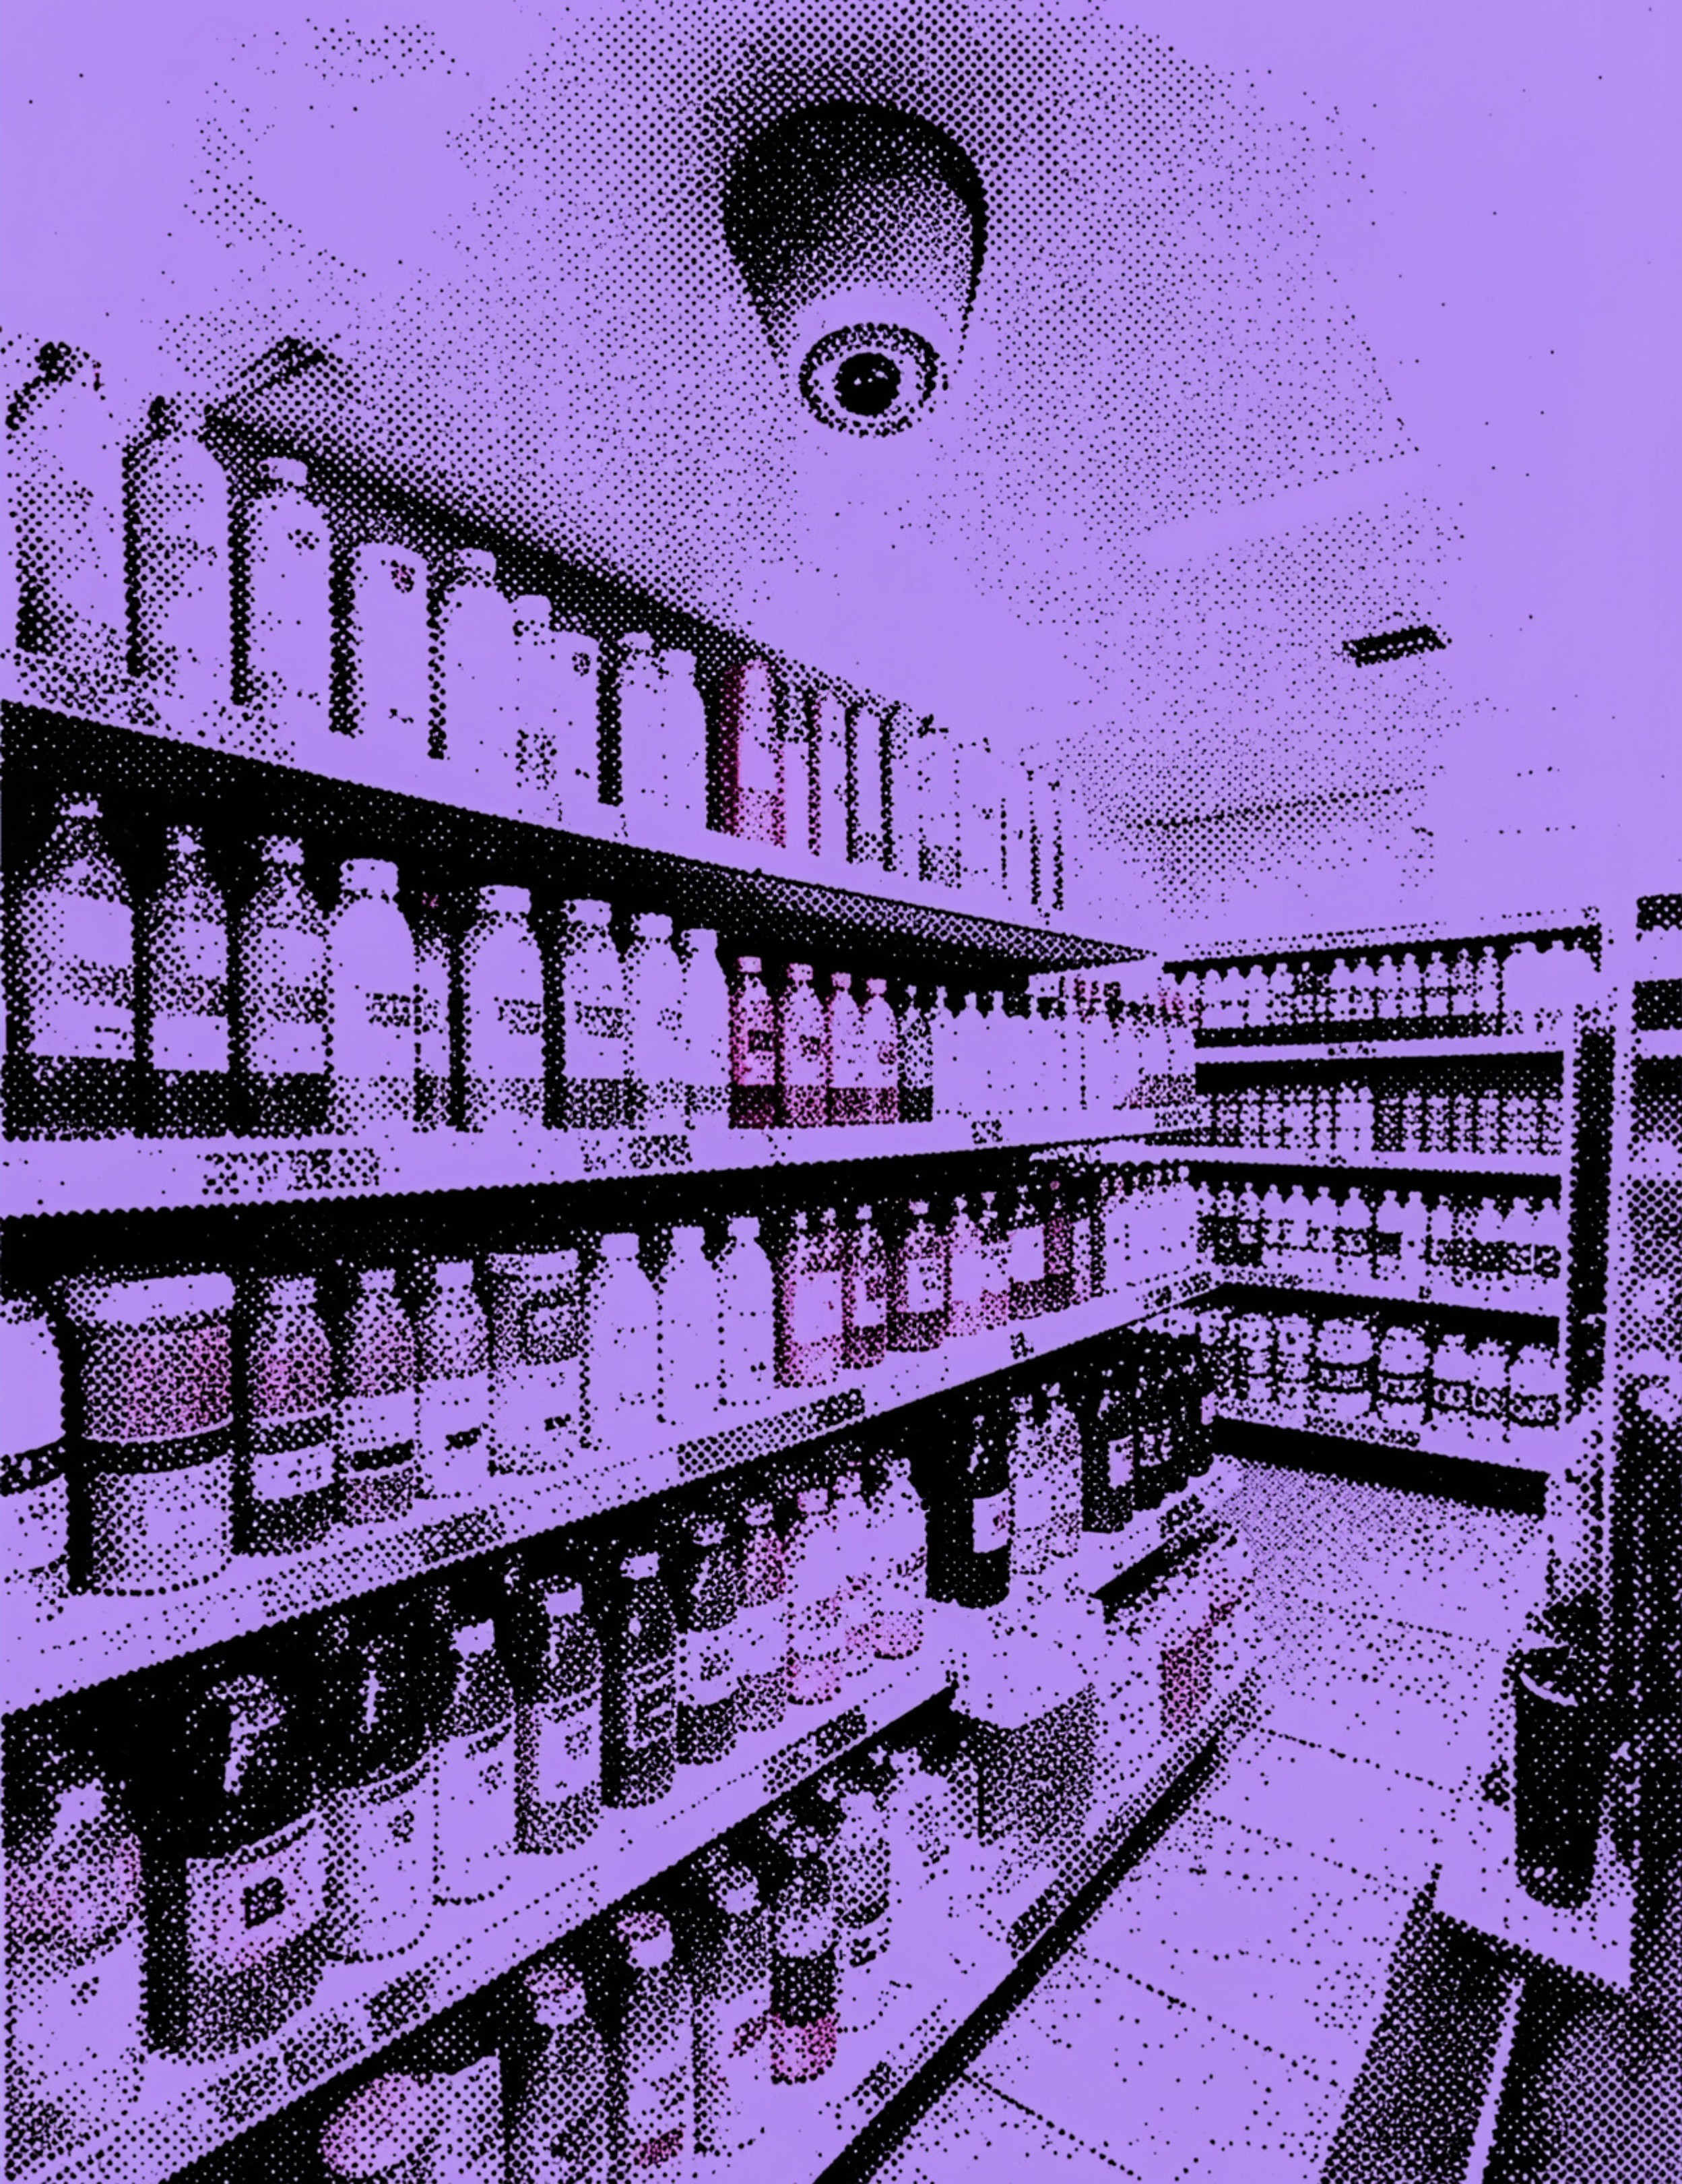
01 · COVERAGE
The prototype covers the store from camera to procurement
TARGET CAMERA EXPERIENCE · 30–45 FPS
Notes:
The prototype spans multi-aisle feeds across cosmetics, beverages and dairy, dry groceries, and concourse movement. Operator views combine detection, alignment, dwell, and performance telemetry.

Slide 13
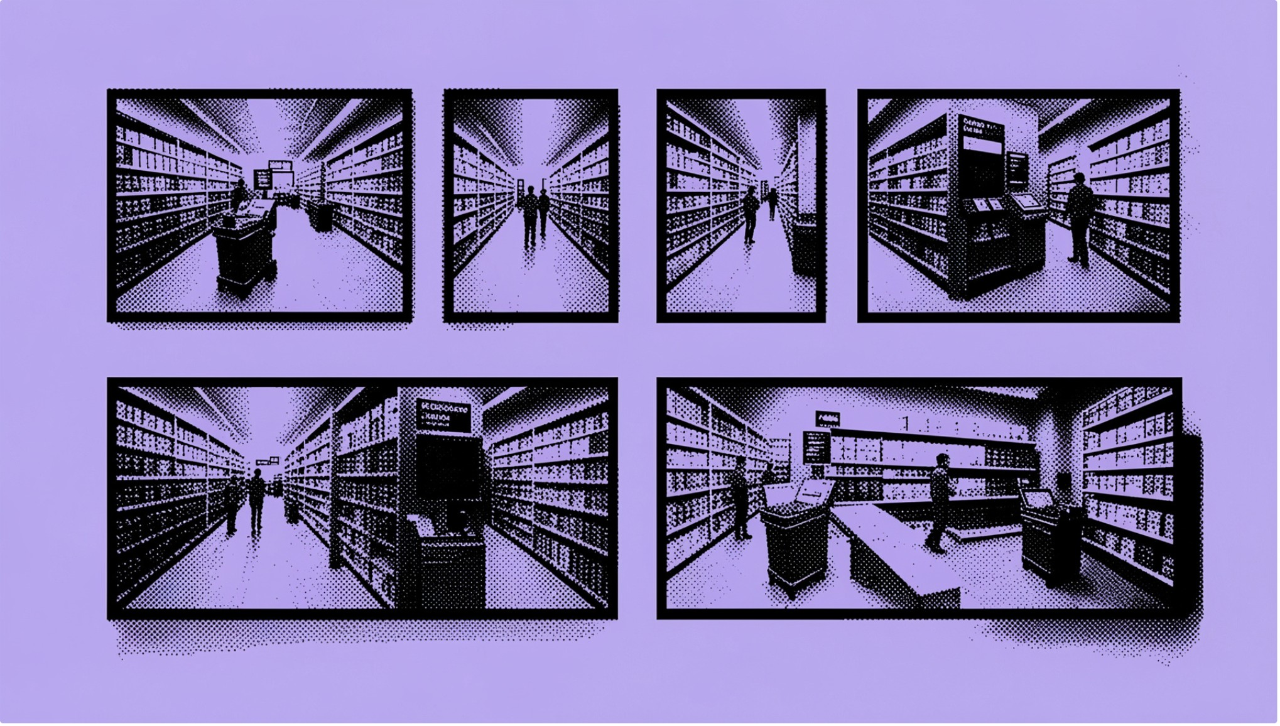
02 · DEMONSTRATION
The working demonstration proves the closed loop
CAMERA_WALL.VIEW
Demonstrate
Shelf depletion, loss-prevention events, self-checkout, and generated tax invoices.
Telemetry drawer
Edge, cloud, POS, and role-based access events.
Implementation screenshots
Camera wall, dashboard, self-checkout, and procurement views.
Notes:
The demonstration is deliberately end to end: shelf depletion, loss prevention, self-checkout, tax invoices, and the telemetry drawer across edge, cloud, POS, and role-based access events.

Slide 14
03 · VALIDATION METHOD
Testing follows the operational lifecycle
Acquire
Prepare
Camera observations, shelf states, POS events, and shopper interactions.
Persistence windows, overlap rules, and normalized telemetry structures.
1
2
3
4
Validate
Test and evaluate
Object labels, occlusion states, planogram positions, and event timestamps.
Pickup, return, stockout, checkout, shrinkage, and low-stock scenarios against latency, reconciliation, and procurement outcomes.
OBSERVATION → VALIDATION → PERSISTENCE → OPERATIONAL OUTCOME
Notes:
Testing mirrors how the system operates. We acquire observations, validate their meaning, prepare stable telemetry, then evaluate scenarios against operational outcomes.

Slide 15

04 · REPORTED RESULTS
Reported results show speed, synchronization, and behavioral control
30–45
FPS
TARGET RANGE FOR THE CAMERA-WALL EXPERIENCE
TELEMETRY
BEHAVIOR
ANALYTICS
<15 ms RTT
Hysteresis
84%
Cited example of sub-second JSON synchronization.
Delays alerts during product inspection and rechecks after occlusion.
Reported or illustrative purchase conversion for dwell time of at least 2.5 minutes.
Notes:
Separate target, cited example, and reported or illustrative result. The figures show the intended operating behavior, while raw test data remains necessary for a final empirical claim.

Slide 16

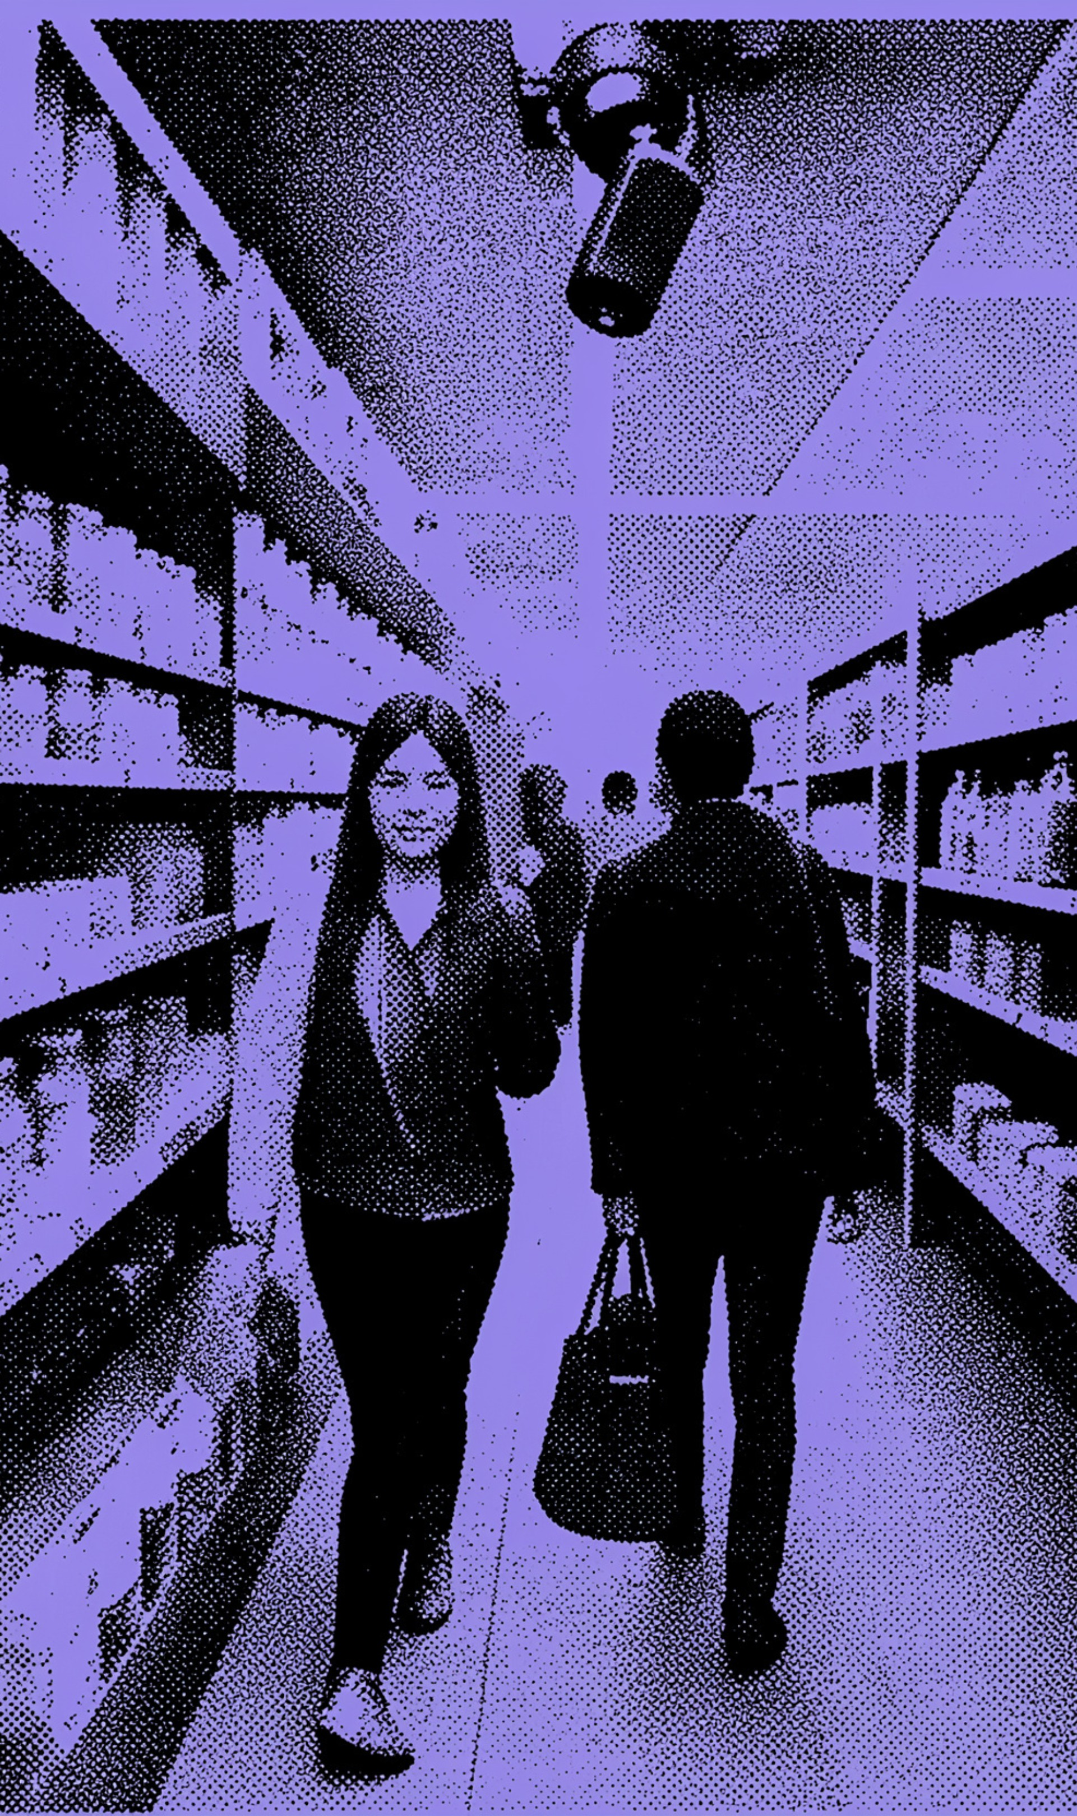
05 · NEXT VALIDATION CYCLE
Testing challenges define the next validation cycle
Occlusion: Shopper overlap can temporarily hide shelf truth.
False alerts: Short product inspections must not become stockout events.
Generalization: Stores, layouts, products, and camera angles need broader validation.
Reliability: Connectivity, camera quality, POS synchronization, and edge capacity affect results.
Direction: Multi-camera re-identification · stronger datasets · ERP connectors · INT8 edge quantization
Notes:
The next cycle addresses the hard cases directly: occlusion, false alerts, generalization, and system reliability. The direction is broader data, stronger identity across cameras, enterprise connectors, and INT8 edge quantization.

Slide 17

06 · ACADEMIC OUTPUT
The final academic paper mirrors the system story
Part A: System & Intelligence
Part B: Implementation & Evaluation
PART A
PART B
System and Intelligence
Implementation and Evaluation
Introduction, related work, problem, objectives, architecture, acquisition, preprocessing, vision, inventory fusion, and analytics.
Implementation, methodology, metrics, results, comparison, security, reliability, limitations, future work, conclusion, and references.
USE THIS STRUCTURE TO CONNECT THE IMPLEMENTATION REVIEW TO THE FINAL PAPER.
Notes:
The paper should preserve the same movement as the system: first explain the intelligence and architecture, then show how it was implemented, evaluated, secured, and bounded by limitations.

Slide 18
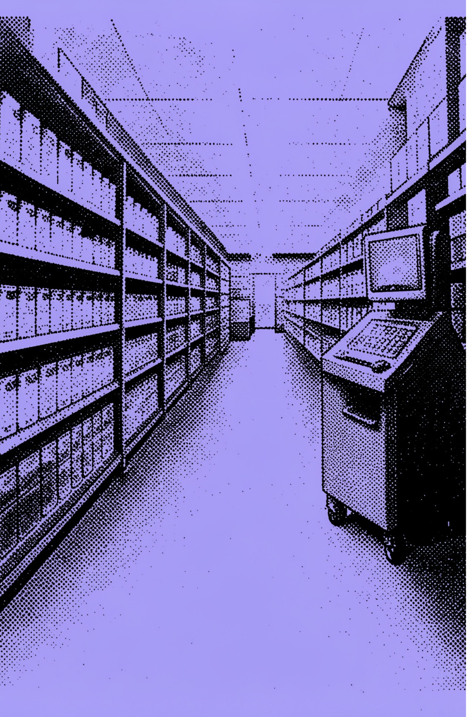
07 · CONCLUSION
Conclusion: the prototype turns vision into operations
Connect
Edge vision, POS reconciliation, analytics, loss prevention, and procurement.
Demonstrate
A closed-loop smart-retail operating concept rather than an isolated detection model.
Translate
Temporal persistence and operational rules translate visual observations into actionable inventory events.
Notes:
Land on the distinction between a detection model and an operating concept. The prototype connects observation, reconciliation, interpretation, and action.

Slide 19
08 · FUTURE WORK
Future work expands coverage and deployment readiness
01
02
03
Expand
Connect
Optimize
Expand datasets and add multi-camera re-identification.
Connect enterprise ERP systems and strengthen procurement integrations.
Optimize edge deployment with INT8 quantization and broader operational testing.
COVERAGE FIRST · INTEGRATION NEXT · DEPLOYMENT AT SCALE
Notes:
Future work is a deployment agenda: broaden the evidence base, connect the system to enterprise operations, and make edge execution more efficient and reliable.

Slide 20
CV-BASED SALES ANALYTICS ENGINE
Thank you
Computer Vision · POS Fusion · Smart Self-Checkout · Automated Procurement
QUESTIONS AND FEEDBACK
Notes:
Close with the system name and the four operating capabilities it connects. Invite questions and feedback.

